Slide 1

April GBM!!

Slide 2

Membership
Not too late!
Membership fee is $20
Receive a free SASA t-shirt
Discount to certain events!
See Angeline or Sabina to become a member today!

Slide 3
Current Event – Japan Earthquake
Japan was struck by another earthquake on April 7th, 2011.
The death toll has risen to 10,000 and 17,000 people are still reported as missing.
Fukushima Daiichi nuclear plant reactors were damaged and has been leaking radiation.

Slide 4
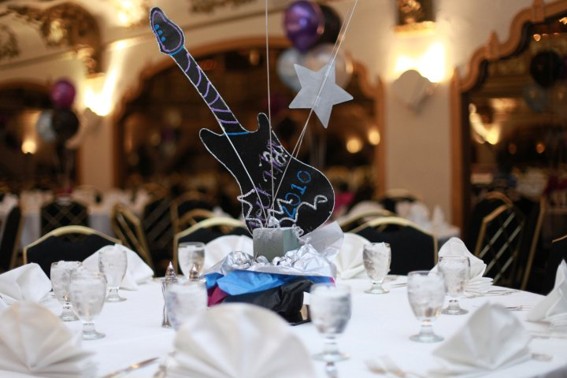
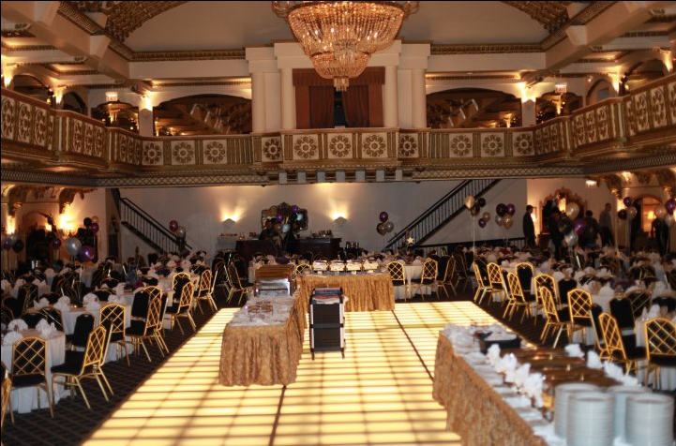
Formal
When: May 6th
Location: Westin Hotel
Formal Chairs: Shreena Shah, Sahrish Moyeed, & Rina Soni
Collaborating with UIC
Appetizers & Dinner

Slide 5
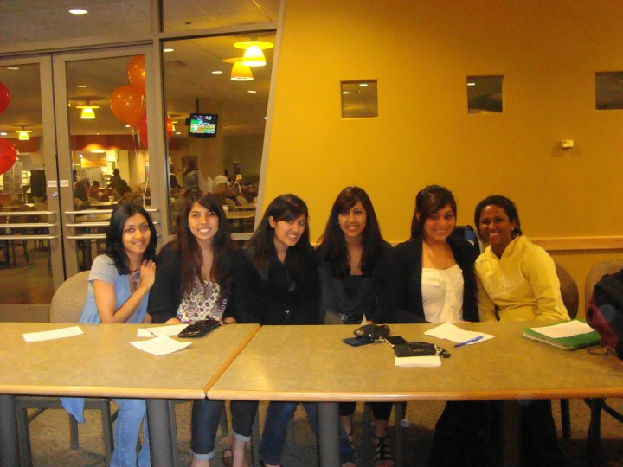
Member Appreciation Dinner
When: May 9th
Where: Student Center
Enjoy great food and SASA awards.
Elections will be held at the dinner.
The position descriptions will be available on the SASA website shortly

Slide 6



FFE and SASA Field Day
When: May 13th
Where: Quad
Come out and enjoy the weather and play some sports.
Refreshments will be provided!

Slide 7
SASA Scholarship
What: This is a scholarship Essay designed for exceptional SASA members who combine the DePaul SASA mission, and Vincentian ideals.
Eligibility: SASA Member, DePaul Student, Current Fresh, Soph, or Junior. Min GPA 3.0.
Will be judged by senior members on board.
Awarded a monetary value to be used for textbooks
More information regarding this will be available soon, including submission deadline and essay requirements

Slide 8
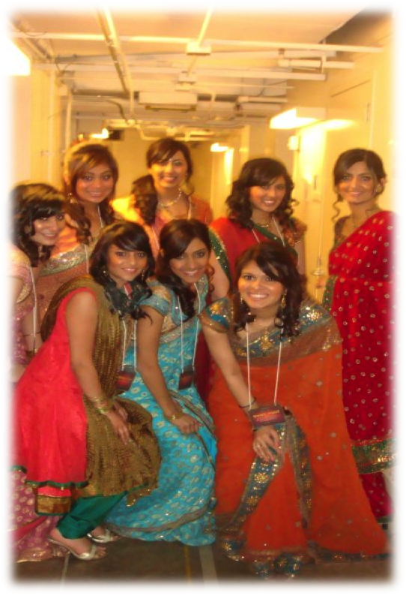
Fashion Show
Cancelled for tomorrow!
Ladies: Bring heels!
Bollywood people:
  Ladies: bring all your jewelry and chaniyas
Hollywood people:
  Girls & Guys: bring your outfits!! (Please coordinate with your partners so that you can match!)
Everyone bring all accessories & Props

Slide 9
Ticket Sales
Ticket Sales
  Lincoln Park Student Center- 11pm-5pm
  DePaul Center 11th Floor- 11pm-5pm
  $15 - VIP
  $10 - General Admission
  2 to 6pm in Lincoln Park on Wed
  Checks made out to DePaul South Asian Students Association
  Member bus leaves at 5:45pm outside SAC
Want to get involved?
  There are still ways you can contribute to show!
  Contact Show chairs after the meeting

Slide 10
Room Reservations
Talk to Priyal Patel after the meeting
SAC Rooms available til 10pm
  Can be booked for Wed & Thurs
Ray rooms may be available
  Can't use Ray rooms under SASA's name

Slide 11
Show Rules
NO ALCOHOL!
  If we catch you drinking at Rehearsal or Show you WILL be kicked out of the show!
Plan Ahead
  You have been aware ahead of time of all meetings’ dates and times; therefore, plan accordingly (re: school)
Strike Policy
  If you miss more than 1 GBM you have to attend at least one of two show committees in April
  **This policy applies to act coordinator meetings!
Please Be Respectful during Rehearsals and Meetings

Slide 12
Dress Rehearsal
Participant Bus - Friday 15th
  Meets at 12:15pm outside Sullivan Athletic Center
  Leaves at 12:30pm SHARP. Bus will not wait.
Check in time is 12:45pm
Rules, Venue Tours,
Begin 1st run-through at 2:00pm
Break at 5:30pm
Begin 2nd run-through at 6:15pm
Participant Bus - Friday 15th
  Leaves NSCPA at 9:30pm, back at SAC by 10:00pm

Slide 13
Dress Rehearsal
ALL PARTICIPANTS MUST BE IN FULL DRESS!
Will not be allowed to leave for any reason
  Cigarette Smoke breaks will only be allowed at the break
2 full fully dressed run-throughs of the show
  All participants must be at their checkpoints!
Tickets may be purchased at dress rehearsal

Slide 14
Show
ALL PARTICIPANTS MAY LEAVE CLOTHES FOR FOLLOWING DAY! (SASA is not responsible for lost or stolen items)
Will not be allowed to leave for any reason
Check in time is 11:00am
12:00pm to 3:00pm are 15 min time slots
  Used for groups to fix timing/space issues
Break at 3:00pm
Participants get ready from 3:30pm to 5:30pm
North Shore rules at 5:30pm
Participants in position at 6:00pm
Doors open at 6:30pm. Show starts at 7:00pm!

Slide 15
www.Depaulsasa.yolasite.com
Join our Facebook
Group today!
DePaul SOUTH ASIAN
STUDENTS ASSOCIATION

